Slide 1

Bring Neural Network To
Algo Trading
Group 6:
Ziwen Chen,
Shasha Li,
Andy He,
Minglu Li

Slide 2


Idea of the Project
Classical questions in financial market:
Fundamental analysis vs Technical Analysis
Validity of Technical indicators
Types of Technical indicators
How to use technical indicators and how good it is
Notes:
Hook
Asset manager, equity researcher, financial advisor -> Fundamental
Traders, hedge fund managers, algo trading developers -> Technical
Types: Momentum, Trend, Volatility…..

Slide 3
Purpose of the Project
To find values of Technical Indicators in Algo Trading through:
Evaluate two groups of technical indicators, Momentum vs Non-momentum, in Neural Network model through comparing model results of predicting SPY’s Up / Flat / Down
Momentum: RSI, CCI, ROC and STO
Non-momentum: VWAP, EMA, BBbands, and EFI
Implement those indicators into Algorithm Trading with ML model, automatically perform Buy / Hold / Sell trades and backtesting them.
Our project is a prototype for further application and research, such as apply into different sectors and can be replaced by other indicators

Slide 4

Two parts of the Project
Apply sequential model to study momentum and Non-momentum technical indicators with the signal, and compare the results from these two models to identify which set outperforms in terms of loss and accuracy
Using SVC classifier model to backtest the algo trading returns from momentum and Non-momentum indicators to demonstrate which set is more “accurate” and “profitable”.

Slide 5

Data Preparation
Daily ohlc and volume data of SPY from 2015-01-01 to today through yfinance API
Using the daily return of SPY to create Buy, Sell, Hold Signal, assuming 1% commission
Notice: This is a multi-class classification problem rather than a binary cross-entropy as suggested by Vini.
For multi-class classification:
activation = “softmax”,
loss function = “categorical_crossentropy”
Notes:
No data No Project
0< daily return < 1% is to hold
Multi-class classification: beyond our in-class activities and online lessons, new territory to explore

Slide 6

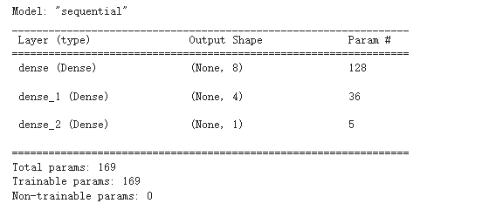
Part 1: Neural Network
Initially, we select and create 15 technical indicators through FINTA library, and use neural network to study them with the signal, hoping to find significant indicators through iterating the model by trimming the indicators.
But we met recurrent neural network input problems caused by
1) indicators are littlely changed in numbers
2) indicators are too many and too complicated
Notes:
Recurrent neural networks problem: whatever how many epochs or indicators the model runs, the accuracy stays at the local minimum and refuses to move.

Slide 7
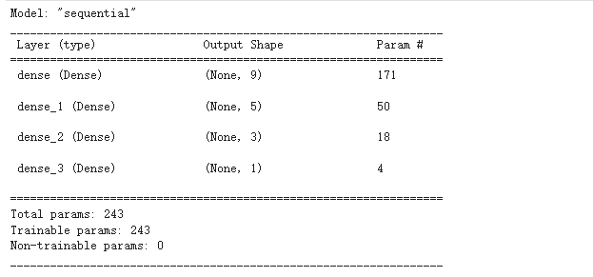
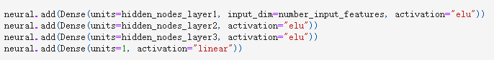
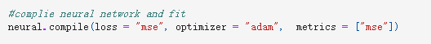
Part 1: Neural Network
Solution:
Only select 4 indicators for momentum and non-momentum set respectively
Encode the indicators and create categorical variables to make indicators more “significant” to the signal and train scaled Xs
Activation function change to “elu” for hidden layers to produce negative output
Activation function change to “linear” for the output layer
Loss function change to “mse”
Metrics change to “mse”
Notes:
Elu can produce negative output and become smooth slower than Relu

Slide 8
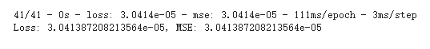
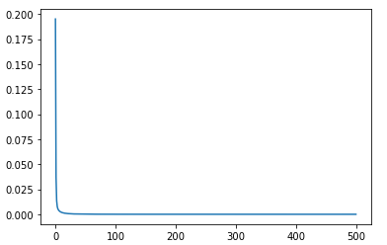
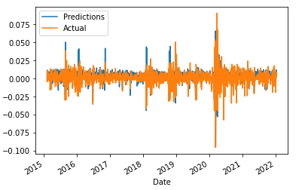
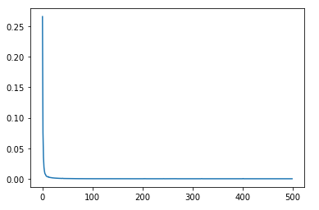
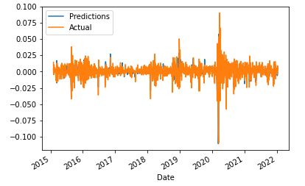
Part 1: Results
The Momentum indicators, with both lower Loss and MSE, outperformed the Non-momentum indicators
Momentum X_train Non-Momentum X_train
VS
Momentum X_test Non-Momentum X_test

Slide 9

Part 2: Machine Learning Backtesting
Then, we apply momentum and non-momentum set into SVC classifier model and backtest the algo return vs actual return
3 Months Training Period
Standard Scaler
RandomOverSampler to resample as ramdom_state=1
Momentum set:
Relative Strength Index “RSI”
Commodity Channel Index “CCI”
Rate-of-change “ROC”
Stochastic Oscillator %K “STOCH”
Non-Momentum set:
Volume Weighted Average Price “VWAP”
Exponential Moving Average “EMA” (9, 70)
Bollinger Bands “BBANDS”
Elder’s Force Index “EFI”

Slide 10
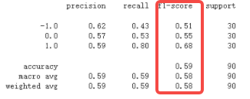
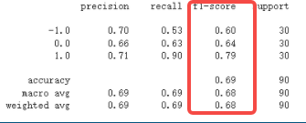
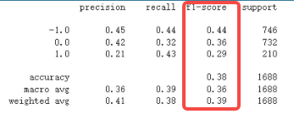
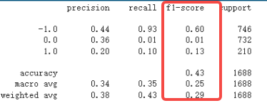
Part 2: Results
Through running SVC model, non-momentum and momentum models yield close results; but overall, non-momentum outperformed momentum set
Momentum y_resampled Non-Momentum y_resampled
VS
Momentum y_test Non-Momentum y_test

Slide 11
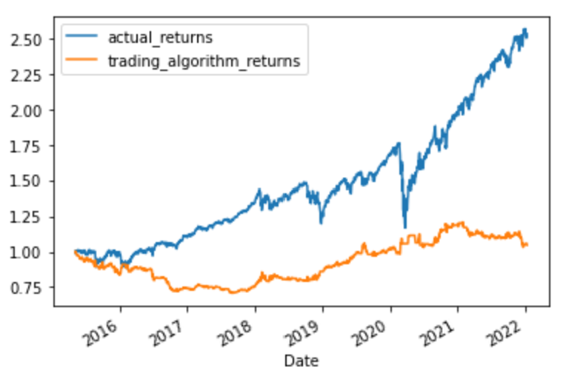
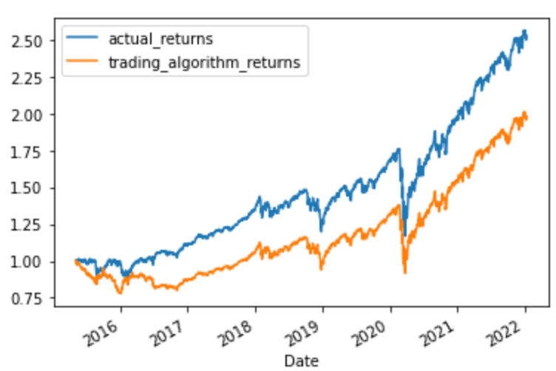
Part 2: Results
Through running SVC model, non-momentum outperformed momentum set in algorithm return; but both sets underperformed than the actual return
Momentum Non-Momentum
VS
tum

Slide 12

Summary
Momentum indicators outperform non-momentum in neural network with lower loss and mse, so momentum indicators might have more “explaining power” to trading signals
Non-momentum indicators outperform momentum in machine learning backtesting with higher f1-score and algorithm returns, so non-momentum indicators might have higher “applicable score” to trading signals
The algorithm trading returns from both sets are underperformed than the actual returns, so generally speaking, applying technical indicators into algorithm trading is still ambiguous

Slide 13

Next Steps
Test more indicators in Algo trading
Run ML-backtesting to each technical indicator
Optimize our model by testing more Classifiers (eg. Logistic_Regression)
Apply the method into different sectors and stocks/ETFs

Slide 14

THANK YOU!
Notes:
Comment #1: Use Long-Short Term Memory from Keras (LSTM) to make the model move from local minimum
Comment #2: 1% Commission might be the reason causing the algo returns underperforming, but it mimics the real world.

